Slide 1
Selenium WebDriver
Selenium WebDriver Advanced Usages
LEVEL – LEARNER

Slide 2
Mehul Mehta(254777) , T, Senthilvel(260750), Lavannya Tankala (244124) and KiranKumarGourisetty(169305)
Automation Center of Excellence
V1.0, 8/10/2012

Slide 3









Icons Used
Hands on Exercise
Questions
Tools
Coding Standards
Test Your Understanding
Reference
A Welcome Break
Demonstration
Contacts

Slide 4
Objectives
After this Session you will be able to:
Work with advanced usages of webdriver
Implicit and Explicit wait
Working with Proxy and Profiles
Grid Implementation
Selenium backed webdriver
Taking Screenshot
HTML 5

Slide 5
Explicit and Implicit Waits
Why?
Waiting is having the automated task execution elapse a certain amount of time before continuing with the next step.
When?
While navigating from one page to another.
Waiting for the Page title.
Wait till element is displayed.
Implicit Wait
An implicit wait is to tell WebDriver to poll the DOM for a certain amount of time when trying to find an element or elements if they are not immediately available. The default setting is 0. Once set, the implicit wait is set for the life of the WebDriver object instance.
WebDriver driver = new FirefoxDriver();
driver.manage().timeouts().implicitlyWait(10, TimeUnit.SECONDS);
driver.get("http://somedomain/url_that_delays_loading");
WebElement myDynamicElement = driver.findElement(By.id("myDynamicElement"));

Slide 6
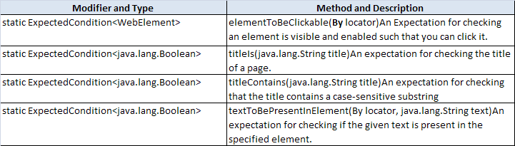
Explicit and Implicit Waits
Explicit Wait - An explicit waits is code you define to wait for a certain condition to occur before proceeding further in the code. The worst case of this is Thread.sleep(). Explicit wait can be implemented using WebDriverWait in combination with ExpectedCondition
Expected Conditions
The Expected Conditions class contains a set of predefined conditions to use with WebDriverWait in Java. Following are some common conditions that are frequently come across when automating web browsers.

Slide 7
Explicit and Implicit Waits
Example
Wait till Element is Clickable - it is Displayed and Enabled
WebDriverWait wait = new WebDriverWait(driver, 10);
WebElement element = wait.until(ExpectedConditions.elementToBeClickable(By.id("someid")));
This waits up to 10 seconds before throwing a TimeoutException or if it finds the element will return it in 0 - 10 seconds.
WebDriverWait by default calls the ExpectedCondition every 500 milliseconds until it returns successfully

Slide 8
Working with Proxy
Working with Proxy
The easiest and recommended way is to manually set the proxy on the machine that will be running the test.
If that is not possible or you want your test to run with a different configuration or proxy, then you can use the following technique that uses a Capabilities object. This temporarily changes the system’s proxy settings and reverts to the original state when done
String PROXY = "localhost:8080";
org.openqa.selenium.Proxy proxy = new org.openqa.selenium.Proxy();
proxy.setHttpProxy(PROXY) ;
proxy.setFtpProxy(PROXY) ;
proxy.setSslProxy(PROXY);
DesiredCapabilities cap = new DesiredCapabailities();
cap.setPreference(CapabilityType.PROXY, proxy);
WebDriver driver = new InternetExplorerDriver(cap);
While setting up proxy for Mac system it is little varied as compared to Windows. On Mac it uses the System Preference -> Network settings.
On Linux it uses (on Ubuntu) System > Preferences > Network Proxy Preferences (Alternatively in “/etc/environment” set http_proxy).

Slide 9
Working With Profiles
When Firefox is used as browser Firefox profiles needs to be selected for the test runs. This is done as below
System.setProperty(“webdriver.firefox.profile”, profile Name);
Web Driver web Driver = new Firefox Driver();
ProfilesIni profilesIni = new ProfilesIni();
// Clone the named profile
Firefox Profile profile = profilesIni.getProfile(profile Name);
Web Driver web Driver = new Firefox Driver(profile);
Both methods start Firefox with a clone of the specified profile. When the Firefox Driver constructor is called without any argument, Web Driver will use the value of the webdriver.firefox.profile system property to identify the profile to clone.
If a Firefox Profile object is passed as an argument to the constructor, the webdriver.firefox.profile system property will simply be ignored. The second approach has its advantage as providing a reference to the Firefox Profile object for further manipulation.

Slide 10
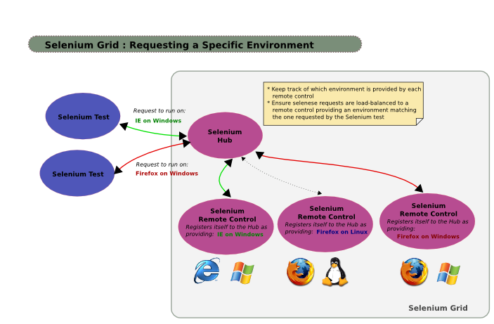
Selenium Grid
What is Selenium-Grid?
Selenium-Grid enables distributed test execution which means it allows user to execute tests in parallel on different machines against different browsers.
When to use it?
To run your tests against multiple browsers, multiple versions of browser, and browsers running on different operating systems.
To reduce the time it takes for the test suite to complete a test pass.
Selenium-Grid Components-A grid consists of a single hub, and one or more nodes. Both are started using the selenium-server.jar executable

Slide 11
Selenium Grid
Selenium-Grid Execution flow
The hub receives a test to be executed along with information on which browser and ‘platform’ (i.e. WINDOWS, LINUX, etc) where the test should be run.
Selects an available node that has the requested browser-platform combination.
Once a node has been selected, Selenium commands initiated by the test are send the the hub, which passes them to the node assigned to that test.
The node runs the browser, and executes the Selenium commands within that browser against the application under test.
Starting Hub
Run the following command from a command-line
java -jar selenium-server-standalone-2.21.0.jar -hub
The default port the hub uses to listen for new requests is port 4444
Starting Node
Run the following command from a command-line
java -jar selenium-server-standalone-2.25.0.jar -role node -hub http://hubIP:4444/grid/register

Slide 12
Working with Grid
DesiredCapabilities capability = DesiredCapabilities.firefox();
WebDriver driver = new RemoteWebDriver(new URL("http://HubIP:4444/wd/hub"), capability);
A node matches if all the requested capabilities are met. To request specific capabilities on the grid, specify them before passing it into the WebDriver object
For Ex: browserName=firefox,version=3.6,platform=LINUX
DesiredCapabilities capability = DesiredCapabilities.firefox();
capability.setBrowserName(“firefox” ); capability.setPlatform(“LINUX”); capability.setVersion(“3.6”); WebDriver driver = new RemoteWebDriver(new URL("http://HubIP:4444/wd/hub"), capability);

Slide 13
Migrating From Selenium RC to Selenium WebDriver
Why to Migrate WebDriver
Better emulation of user interactions.
Support by browser vendors such as Opera, Mozilla and Google, and each have engineers working to improve the framework.
No support available for Selenium RC issues.
Steps to be followed to migrate existing Selenium RC project
Execute existing RC script with latest Selenium release, to eliminate application/script issues.
Creating Selenium instance from webDriver
WebDriver driver = new FirefoxDriver();
Selenium selenium = new WebDriverBackedSelenium(driver, "http://www.google.com");
Now use WebDriverBackedSelenium instance in test scripts and see that all test case are passing.
Extracting the underlying WebDriver implementation from the Selenium instance
WebDriver driver = ((WrapsDriver) selenium).getWrappedDriver();
This allows you to continue passing the Selenium instance around as normal, but to unwrap the WebDriver instance as required.The next stage is to migrate the actual test code to use the WebDriver APIs.

Slide 14
Taking Screenshot
You can take screenshot when an failure occurs.
File scrFile = ((TakesScreenshot) driver ).getScreenshotAs(OutputType.FILE);
RemoteWebDriver does not implement the TakesScreenshot class. Thus Augmenter will add the TakesScreenshot methods to the instance
WebDriver driver = new RemoteWebDriver( new URL("http://localhost:4444/wd/hub"), DesiredCapabilities.firefox());
WebDriver augmentedDriver = new Augmenter().augment(driver);
File screenshot = ((TakesScreenshot)augmentedDriver). getScreenshotAs(OutputType.FILE);

Slide 15
Selenium WebDriver Advanced Usages
HTML5
HTML5 is becoming on the of the biggest things to hit the internet. Unfortunately it has also meant that Selenium RC has hit a wall in with which technologies it can interact with. It can't play with these new technologies like canvas.
The WebDriver API is trying to solve a number of these problems with the way that it drives the browser.
The Advanced User Interactions API allows us to do things like dragging and dropping as well as gives us the ability to do something like hold down a key and move the mouse around or carry on typing. This API only works on Linux and Windows.

Slide 16
Selenium WebDriver Advanced Usages
The code snippet allows you to draw what you want on a canvas element on the page. The script below will draw a triangle on the canvas.
Using HTML5 we can perform drawing and some other new explorative things which come up in late development of Selenium WebDriver.
from selenium import webdriver
from selenium.webdriver.common.action_chains import ActionChains
class TestCanvas:
def setup_method(self, method):
self.firefox = webdriver.Firefox()
def teardown_method(self, method):
self.firefox.quit() def test_that_we_can_draw_on_canvas(self):
self.firefox.get('http://www.theautomatedtester.co.uk/demo1.html')
canvas = self.firefox.find_element_by_id("tutorial")
drawing = ActionChains(self.firefox)\
.click_and_hold(canvas)\
.move_by_offset(-40, -60)\
.move_by_offset(30, 20)\
.move_by_offset(100, 200)\
.release(canvas)
.drawing.perform()

Slide 17
Selenium WebDriver Advanced Usages
Another sample using Html 5 for drag and drop
from selenium import webdriver
from selenium.webdriver.common.action_chains import ActionChains
class TestDragAndDrop:
def setup_method(self, method):
self.firefox = webdriver.Firefox()
def teardown_method(self, method):
self.firefox.quit()
def test_that_we_can_drag and_drop(self):
self.firefox.get('http://www.theautomatedtester.co.uk/demo2.html')
draggable =self.firefox.find_element_by_class_name("draggable")
droppable = self.firefox.find_element_by_id("droppable")
dragdrop = ActionChains(self.firefox)\.drag_and_drop(draggable, droppable)
//Now we know what we want to happen, let's perform the actions
dragdrop.perform()

Slide 18
Demonstration

Slide 19
Page Object Model
Page Objects are a representation of a web page. All elements seen on the web page can be interacted using their respective methods in the page object.
Allows you to model the UI, but not recreate it
Exposes methods for actions in the UI, such as
UserRegistration.getFullname();
UserRegistration.setLastname();
Consolidates code specific to UI elements
getFullname() is found on User Registration page.
Not tied to a specific framework Can be used in Selenium, WebTest, QTP, etc.

Slide 20
Page Object Model
Page objects are abstracted into classes. As such, they lend themselves greatly to reusability in object oriented languages such as Java and C#.
Decreases duplicate code
Constants can be used and overloaded, depending on the data requirements or test case behavior.
Since a single Page Object can be used across multiple testing scenarios (e.g. Login LP), and gets called by each test, you only need to update one class (Login.LP Page Object) when the page changes.
Productivity gains:
Quickly identify the location of required methods
Test development is more simplistic and can be data driven
Reusability of multiple Page Objects allow for user flows to be scripted more quickly
Test code is more readable

Slide 21
Demonstration

Slide 22
Questions

Slide 23
Break

Slide 24
Test Your Understanding
What is Implicit Wait?
What is Explicit Wait?
What is the Desired capability Objective and when it is used?
What is remote Webdriver?

Slide 25
Summary
WebDriver usage for Implicit and Explicit
Use of Remote WebDriver
Profile Maintenance
Desired Capabilities Objectives
Html5 usage of canvas etc.,

Slide 26
Source
http://seleniumhq.org/
Disclaimer: Parts of the content of this course is based on the materials available from the Web sites and books listed above. The materials that can be accessed from linked sites are not maintained by Cognizant Academy and we are not responsible for the contents thereof. All trademarks, service marks, and trade names in this course are the marks of the respective owner(s).

Slide 27
Selenium WebDriver
You have successfully completed -
Selenium WebDriver Advanced Usages

